Slide 1

Financial Results H1 2019
Konrad Tarański, Vice-President of the Management Board, CFO
3rd of September 2019, Warsaw

Slide 2
Agenda
Revenue and Financial Results for Q2 and H1 2019
Influence of IRFS 16
Cash Flow H1 2019
Human Resources
Investments
Summary

Slide 3
Agenda
Revenue and Financial Results for Q2 and H1 2019
Influence of IRFS 16
Cash Flow H1 2019
Human Resources
Investments
Summary

Slide 4
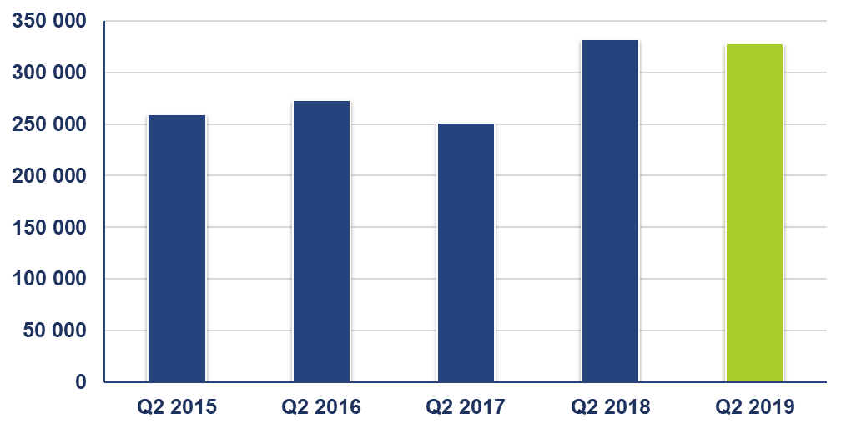
Sales Revenue Q2 2019 (Comarch Group)
In PLN thou.
From 1st of January 2018, the Group started using the principles resulting from IFRS 15 for sales revenue. For comparative purposes, the transformation of data for the first, second, third and fourth quarter of 2017 was made in accordance with IFRS 15.

Slide 5
Market Sales Structure Q2 2019
In PLN thou.

Slide 6
Products Sales Strusture Q2 2019
In PLN thou.

Slide 7
Consolidated Financial Results Q2 2019
In PLN thou.

Slide 8
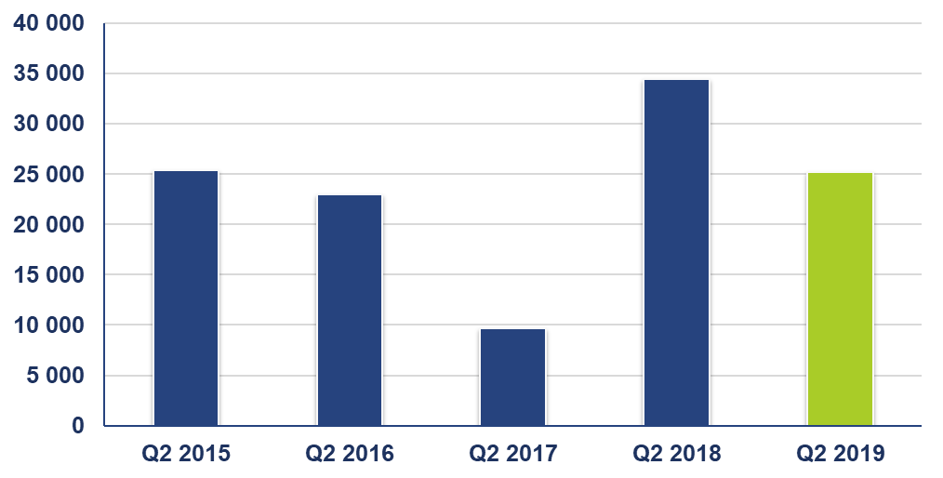
Operating Profit Q2 2019 (Comarch Group)
In PLN thou.
From 1st of January 2018, the Group started using the principles resulting from IFRS 15 for sales revenue. For comparative purposes, the transformation of data for the first, second, third and fourth quarter of 2017 was made in accordance with IFRS 15. Data for 2015 and 2016 were not transformed in accordance with IFRS 15.
From 1st of January 2019, the Group started using the principles resulting from IFRS 16. Data for 2015 – 2018 were not transformed in accordance with IFRS 16.

Slide 9
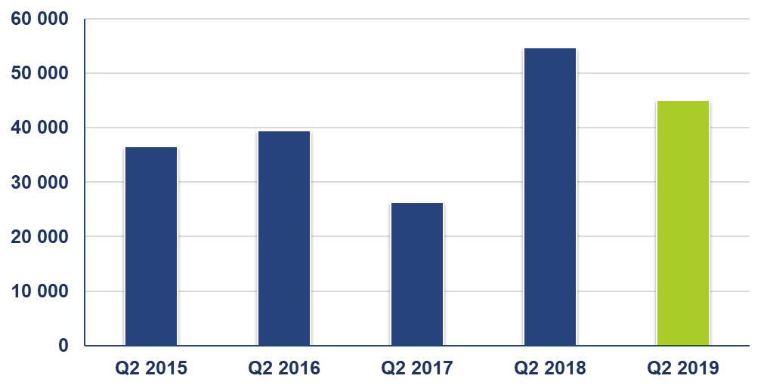
EBITDA Q2 2019 (Comarch Group)
In PLN thou.
From 1st of January 2018, the Group started using the principles resulting from IFRS 15 for sales revenue. For comparative purposes, the transformation of data for the first, second, third and fourth quarter of 2017 was made in accordance with IFRS 15. Data for 2015 and 2016 were not transformed in accordance with IFRS 15.
From 1st of January 2019, the Group started using the principles resulting from IFRS 16. In Q2 2019, depreciation and EBITDA increased by PLN 4,734 thousand, as a result of using the principles resulting from IFRS 16. Data for 2015 - 2018 were not transformed in accordance with IFRS 16.

Slide 10
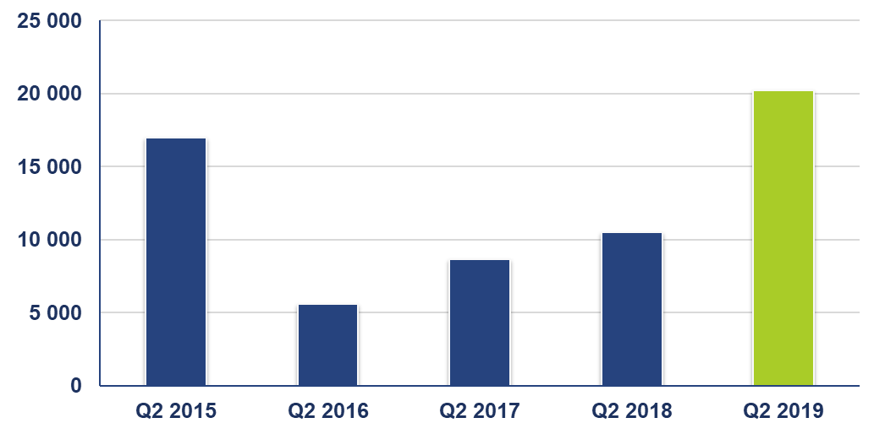
Net Profit Q2 2019
In PLN thou.
From 1st of January 2018, the Group started using the principles resulting from IFRS 15 for sales revenue. For comparative purposes, the transformation of data for the first, second, third and fourth quarter of 2017 was made in accordance with IFRS 15. Data for 2015 and 2016 were not transformed in accordance with IFRS 15.
From 1st of January 2019, the Group started using the principles resulting from IFRS 16. Data for 2015 – 2018 were not transformed in accordance with IFRS 16.

Slide 11
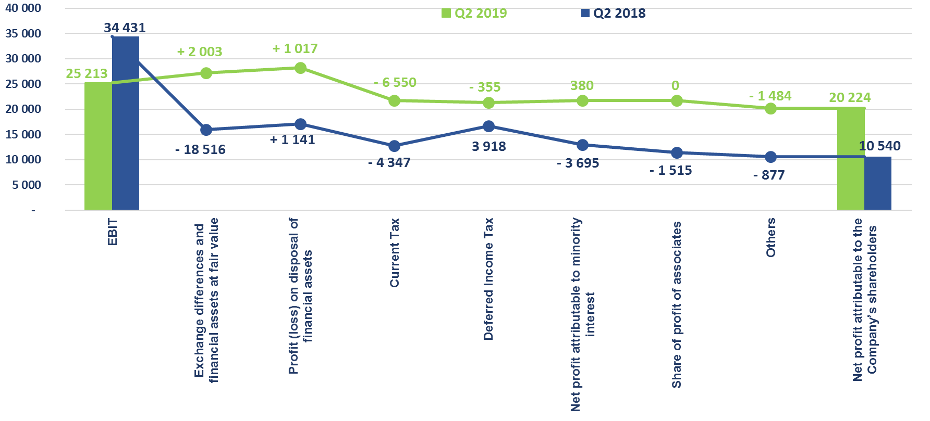
EBIT vs. Net Profit Q2 2019 (Comarch Group)
In PLN thou.

Slide 12
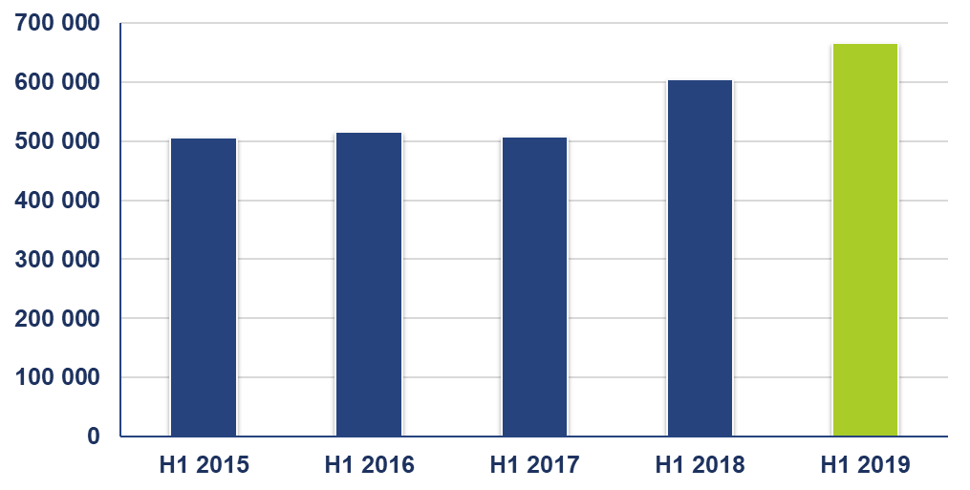
Sales Revenue H1 2019 (Comarch Group)
In PLN thou.
From 1st of January 2018, the Group started using the principles resulting from IFRS 15 for sales revenue. For comparative purposes, the transformation of data for the first, second, third and fourth quarter of 2017 was made in accordance with IFRS 15.

Slide 13
Market Sales Structure H1 2019
In PLN thou.

Slide 14
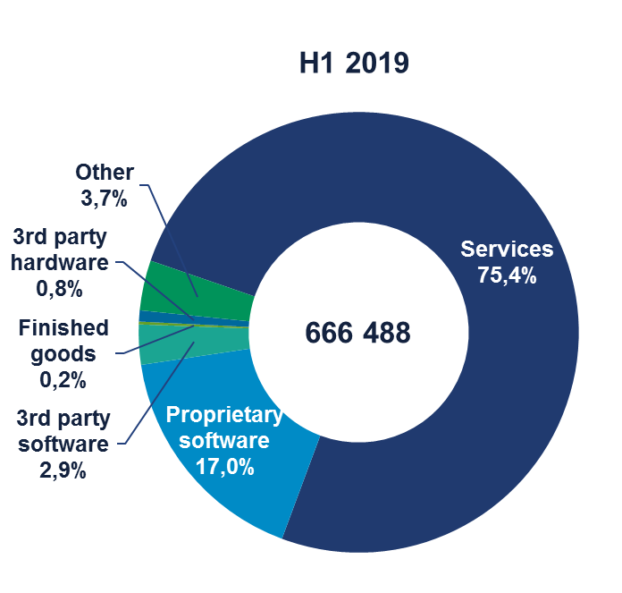
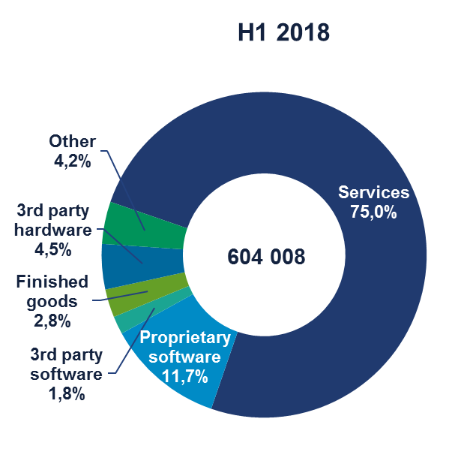
Products Sales Structure H1 2019
In PLN thou.

Slide 15
Consolidated Financial Results H1 2019
In PLN thou.

Slide 16
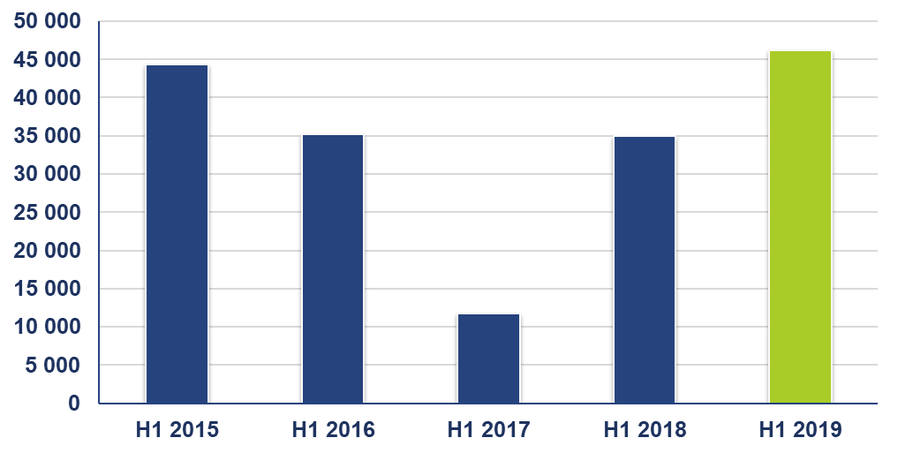
Operating Profit H1 2019 (Comarch Group)
In PLN thou.
From 1st of January 2018, the Group started using the principles resulting from IFRS 15 for sales revenue. For comparative purposes, the transformation of data for the first, second, third and fourth quarter of 2017 was made in accordance with IFRS 15. Data for 2015 and 2016 were not transformed in accordance with IFRS 15.
From 1st of January 2019, the Group started using the principles resulting from IFRS 16. Data for 2015 – 2018 were not transformed in accordance with IFRS 16.

Slide 17
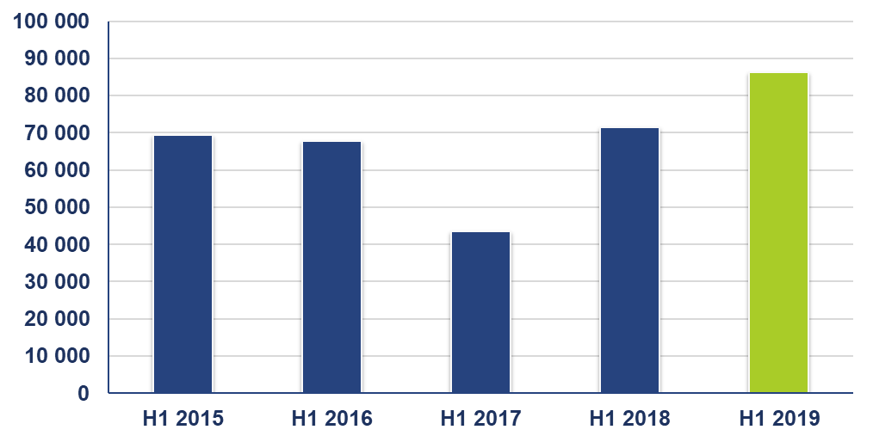
EBITDA H1 2019 (Comarch Group)
In PLN thou.
From 1st of January 2018, the Group started using the principles resulting from IFRS 15 for sales revenue. For comparative purposes, the transformation of data for the first, second, third and fourth quarter of 2017 was made in accordance with IFRS 15. Data for 2015 and 2016 were not transformed in accordance with IFRS 15.
From 1st of January 2019, the Group started using the principles resulting from IFRS 16. In Q2 2019, depreciation and EBITDA increased by PLN 206 thousand, as a result of using the principles resulting from IFRS 16. Data for 2015 - 2018 were not transformed in accordance with IFRS 16.

Slide 18
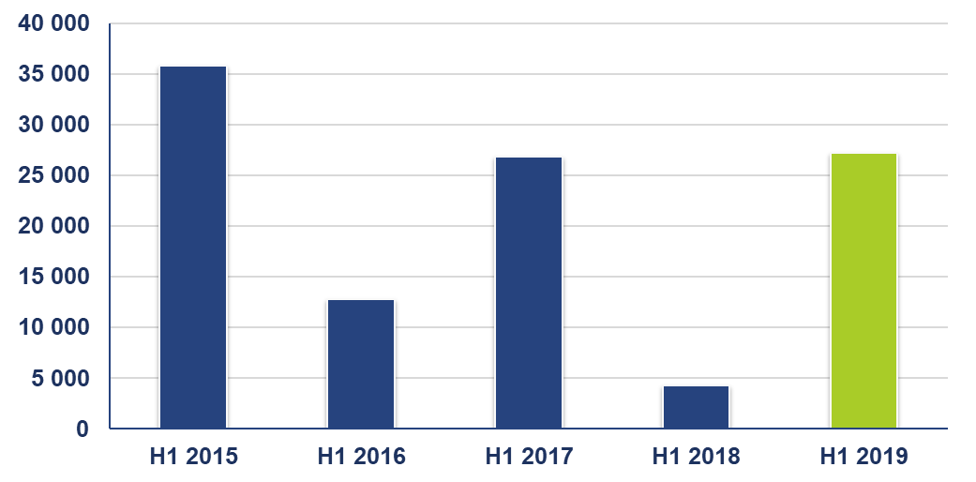
Net Profit H1 2019 (Comarch Group)
In PLN thou.
From 1st of January 2018, the Group started using the principles resulting from IFRS 15 for sales revenue. For comparative purposes, the transformation of data for the first, second, third and fourth quarter of 2017 was made in accordance with IFRS 15. Data for 2015 and 2016 were not transformed in accordance with IFRS 15.
From 1st of January 2019, the Group started using the principles resulting from IFRS 16. Data for 2015 – 2018 were not transformed in accordance with IFRS 16.

Slide 19
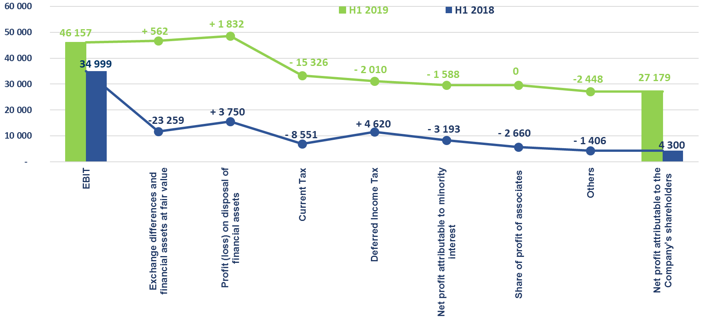
EBIT vs. Net Profit H1 2019 (Comarch Goup)
w tys. PLN

Slide 20
Agenda
Revenue and Financial Results for Q2 and H1 2019
Influence of IRFS 16
Cash Flow H1 2019
Human Resources
Investments
Summary

Slide 21
Influence of MSSF 16 in H1 2019

Slide 22
Agenda
Revenue and Financial Results for Q2 and H1 2019
Influence of IRFS 16
Cash Flow H1 2019
Human Resources
Investments
Summary

Slide 23
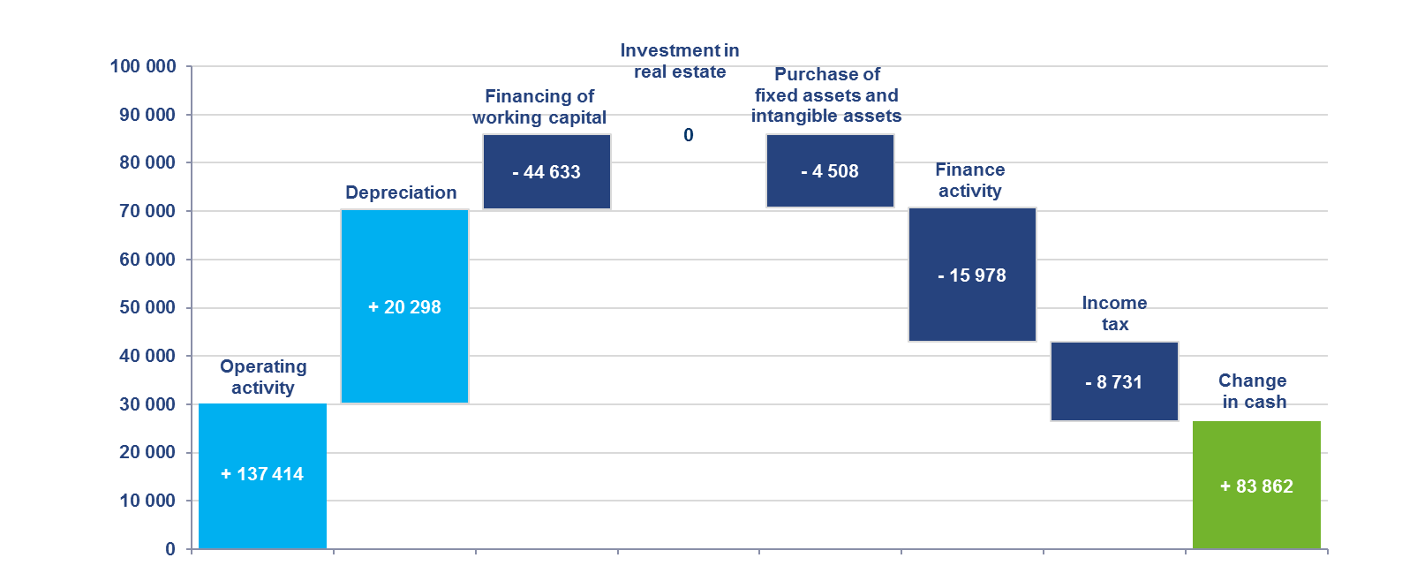
Cash flow H1 2019

Slide 24
Agenda
Revenue and Financial Results for Q2 and H1 2019
Influence of IRFS 16
Cash Flow H1 2019
Human Resources
Investments
Summary

Slide 25
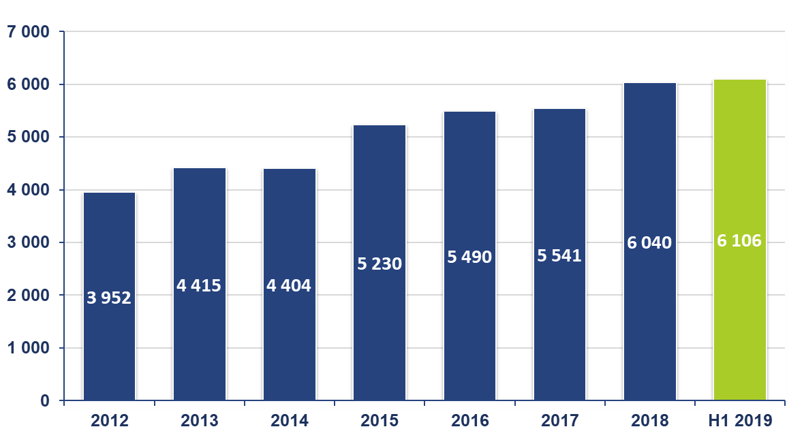
Employment in Comarch Group

Slide 26
Employment
As at the 30th of June, 2019, the Comarch Group hired 6,106 persons, i.e. 66 persons more (1.1%) than as at the 31st of December, 2018
The fund of basic salaries in the reporting period was 14% higher than in H1 2018

Slide 27
Agenda
Revenue and Financial Results for Q2 and H1 2019
Influence of IRFS 16
Cash Flow H1 2019
Human Resources
Investments
Summary

Slide 28
Investments
In H1 2019, Comarch Group has continued of development works within IT solutions, as well as invested in development of own IT technologies (among others Comarch Cloud)
In H1 2019, Group started implementation of a new infrastructure investment –Traning Center MKS Cracovia in Rączna
Group conducts preparatory works related to investment in Comarch Data Center in United States

Slide 29
Agenda
Revenue and Financial Results for Q2 and H1 2019
Influence of IRFS 16
Cash Flow H1 2019
Human Resources
Investments
Summary

Slide 30
Summary H1 2019
Revenue from sale increased faster than operating costs and amounted to PLN 62.4 milion, i.e. increase of 10.3% – as a result, operating profitability increased to +6.9% and net profitability increased to +4.1%
Revenue from export sales increased by 18.7%, thanks to higher sales of IT solutions to the customers from the TMT sector and the Trade and Service sector in Europe and Asia
Stabilization of domestic sales – after a large increase in revenue in Q1 2019, in Q2 there was a significant decrease in revenue from sales to customers from the Public sector. There was a result of lack of a supplies of finished goods to one of the public institutions in Q2 2019, (which occurred in Q2 2018)
Application of the IFRS 16 accounting standard for the first time, which caused that the value of depreciation, and thus the value of EBITDA, increased in H1 2019 by PLN 9,206 thousand
AGM of Comarch S.A. passed the resolutions regarding payment of dividend PLN 1.50 per share

Slide 31
AGM 2019 – Appointment of Supervising and Managing Persons
AGM of Comarch S.A. appointed Supervisory Board of Comarch S.A. for another term:
Elżbieta Filipiak (Chairperson of the Supervisory Board)
Andrzej Pach (Vice Chairman of the Supervisory Board)
Danuta Drobniak
Łukasz Kalinowski
Joanna Krasodomska
Anna Pruska
Tadeusz Włudyka
AGM of Comarch S.A. appointed Management Board of Comarch S.A. for another term :
Janusz Filipiak (President of the Management Board)
Marcin Dąbrowski
Paweł Prokop
Andrzej Przewięźlikowski
Zbigniew Rymarczyk
Konrad Tarański
Marcin Warwas

Slide 32
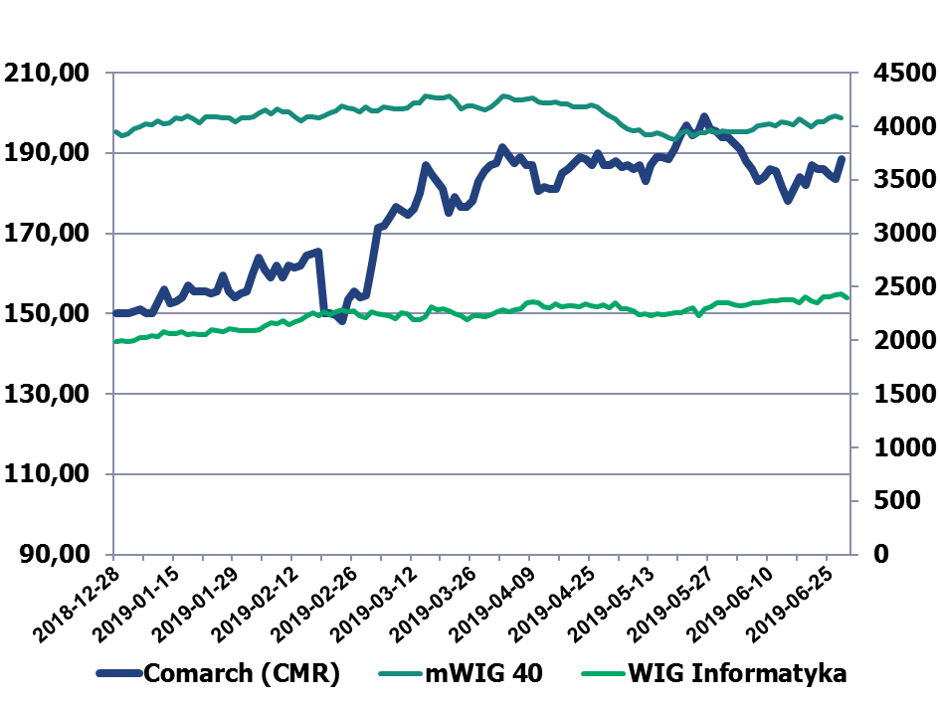
Comarch Stock Price on WSE (1.01.2019 – 30.06.2019)

Slide 33
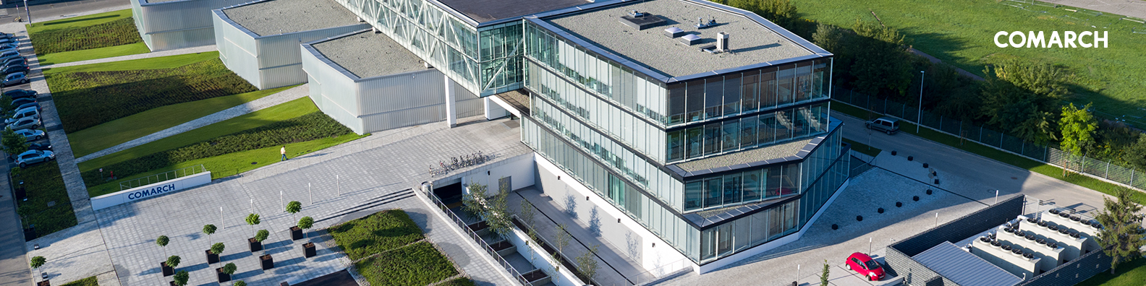
Thank you for attention!

